Slide 1
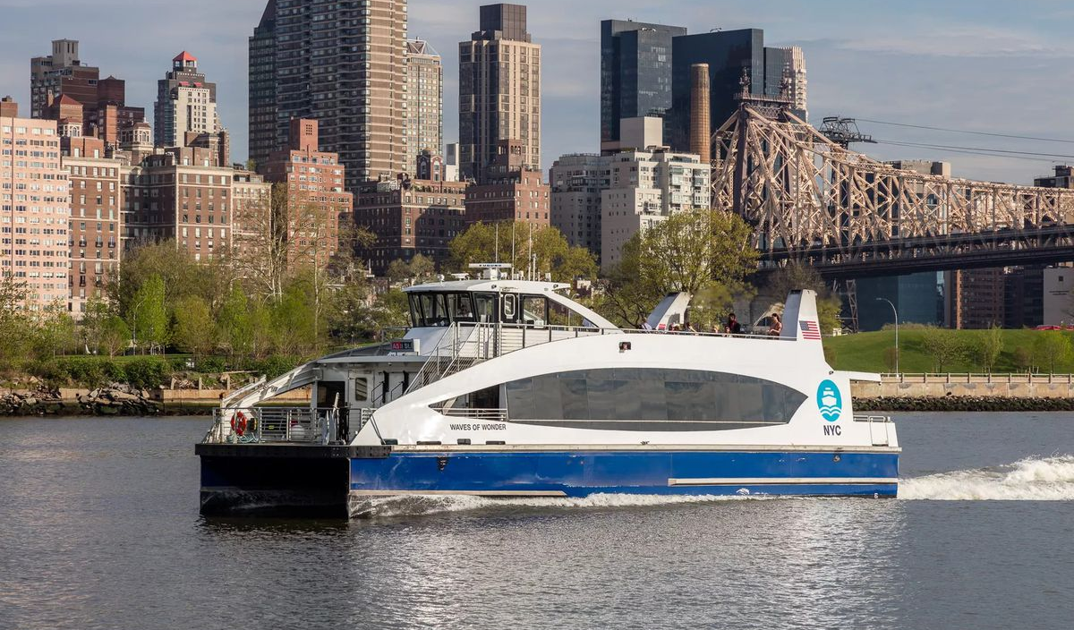

NYC Ferry
Is it sustainable? Solutions?

Slide 2
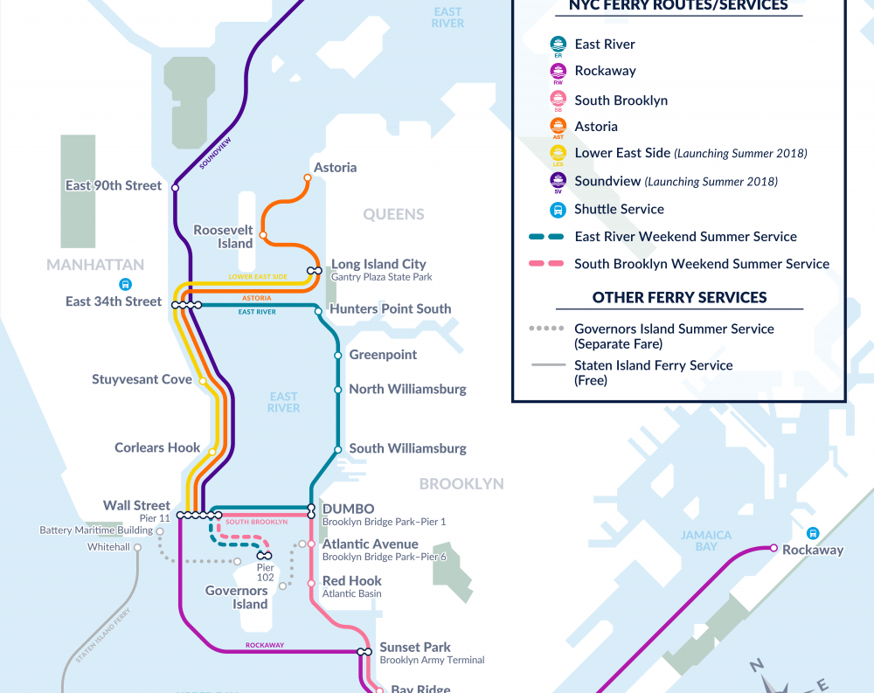
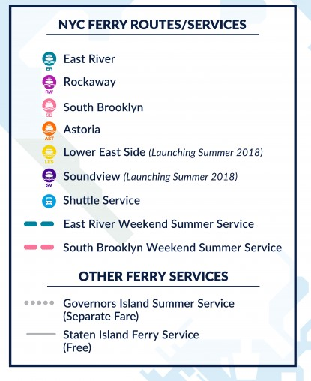
Routes/Services

Slide 3
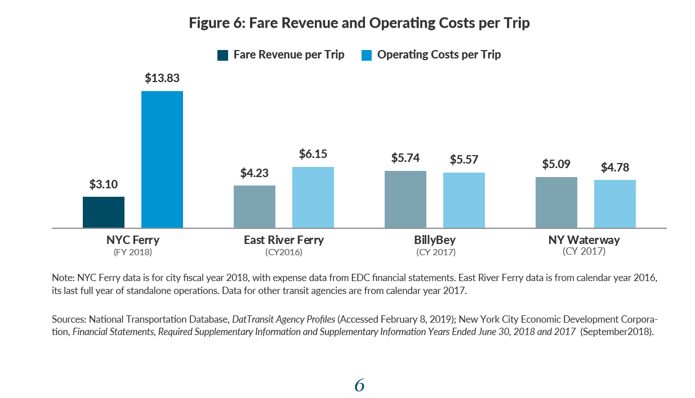
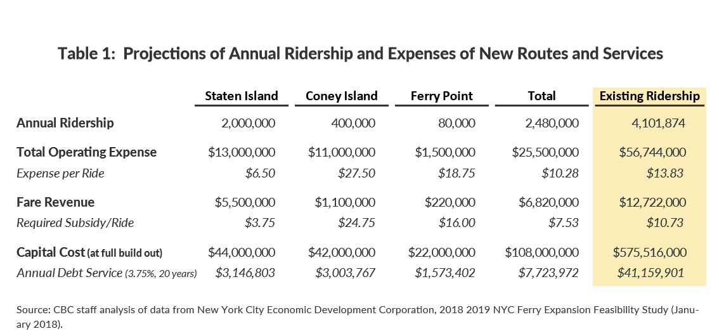
analysis

Slide 4
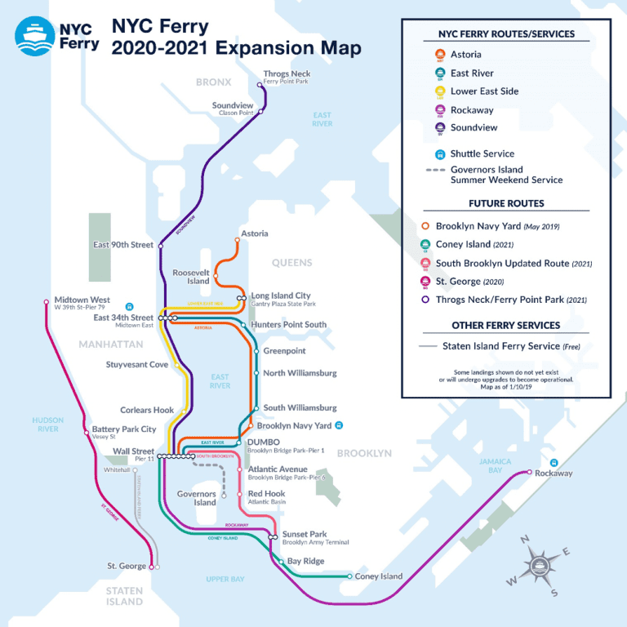
continue Analysis
 | Number of Riders | Fare Revenue | Total Operating Expense | $ Loss
2018 | 4.1 | 12.7 | 56.7 | 44
2019 | 6.3 | 18.5 | 56.7 | 38.2
2020 | 9.2 | 27 | 81.7 | 54.7
2021 | 11 | 33 | 81.7 | 48.7
 |  |  |  | 185

Slide 5
Conclusion
NYC Ferry will continue to need Subsidy from government to function.
Need to cut routes or change routes to cut operation costs.

Slide 6
Sources
https://www.ferry.nyc/reports-statistics/
https://cbcny.org/sites/default/files/media/files/REPORT_NYCFERRY_03282019_0.pdf
https://www.nytimes.com/2019/04/17/nyregion/new-york-ferry.html

